Slide 1

Student Details
NAMe:vellam chetty sri durga Vijaya bhavani.
Aicte internship student registration id:
E-mail id:
STU6436b440690461681306688.
durgabhavanivc@gmail.com

Slide 2
Flipkart clone
Main intension behind this project is to know practically how the developers develops such interface and how it works?
I have prepared this flipkart clone .
It resembles the same as flipkart official website.
Both my project interface and flipkart interface is same.

Slide 3
AGENDA
Website cloning means creating a replica of your existing website to make the changes. It lets developers and designers create blueprints, test compatibility, and perform updates safely before pushing the changes live on your live website.
quality and scalable website clone script allows you to quickly launch your website thus saving you development time.
A clone script costs much less compared to a web development from scratch.
Quality website clone scripts are more than just a ‘copy’ of the reference site; they are more like a replica of attributes with added new features, different functionality and UI/UX, which adds significant value to the niche requirements of users and making the scripts more beneficial and useful.
Eliminates the need for you to do business planning, market research and strategy implementation for UID (User Interface Design)
A cost-effective way to ‘beta test’ your strategy in order to enter into a particular online market with your website.

Slide 4
PROJECT OVERVIEW
I developed this project using frontend technologies like html, css,javascript,bootstrap.
Html is used to develop website interface.
Css is used to style my website.
Javascript is used to add functionality to my website.
Bootstrap is used top add frameworks.
Frontend technology provides developers many tools to create good UI,good user interface.
Which makes it easy for common people to understand what their website is about.

Slide 5
WHO ARE THE END USERS of this project?
End users of this project are customers who wish to buy their desired products.
And the people who uses this website.
Or any pe0ple who uses this website

Slide 6
YOUR SOLUTION AND ITS VALUE PROPOSITION
Through this e commerce site end users come to know what or which type of products are there in our website by sitting in their places.
Now a days people are very busy with their own works .so they don’t find enough time to go out and shop for themselves.
Online shopping websites are the best solutions for this problem.
Not only the shopping websites there are several other websites .All those websites provides different solutions for different problems.

Slide 7
How did you customize the project and make it your own
In my project .you can choose women’s dress by clicking on see more under women’s section .
There is an option to add into cart and also there is log in or sing up option through which we can register ourselves.
There is also a payment option means mode of payment we can choose any one of those as our wish.

Slide 8
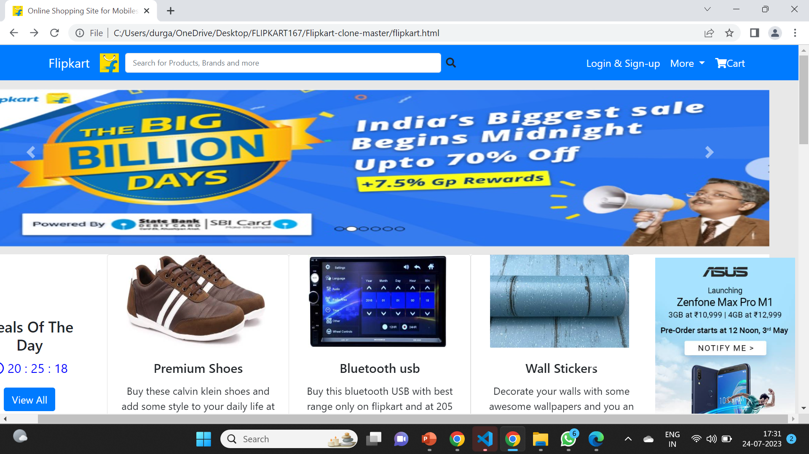
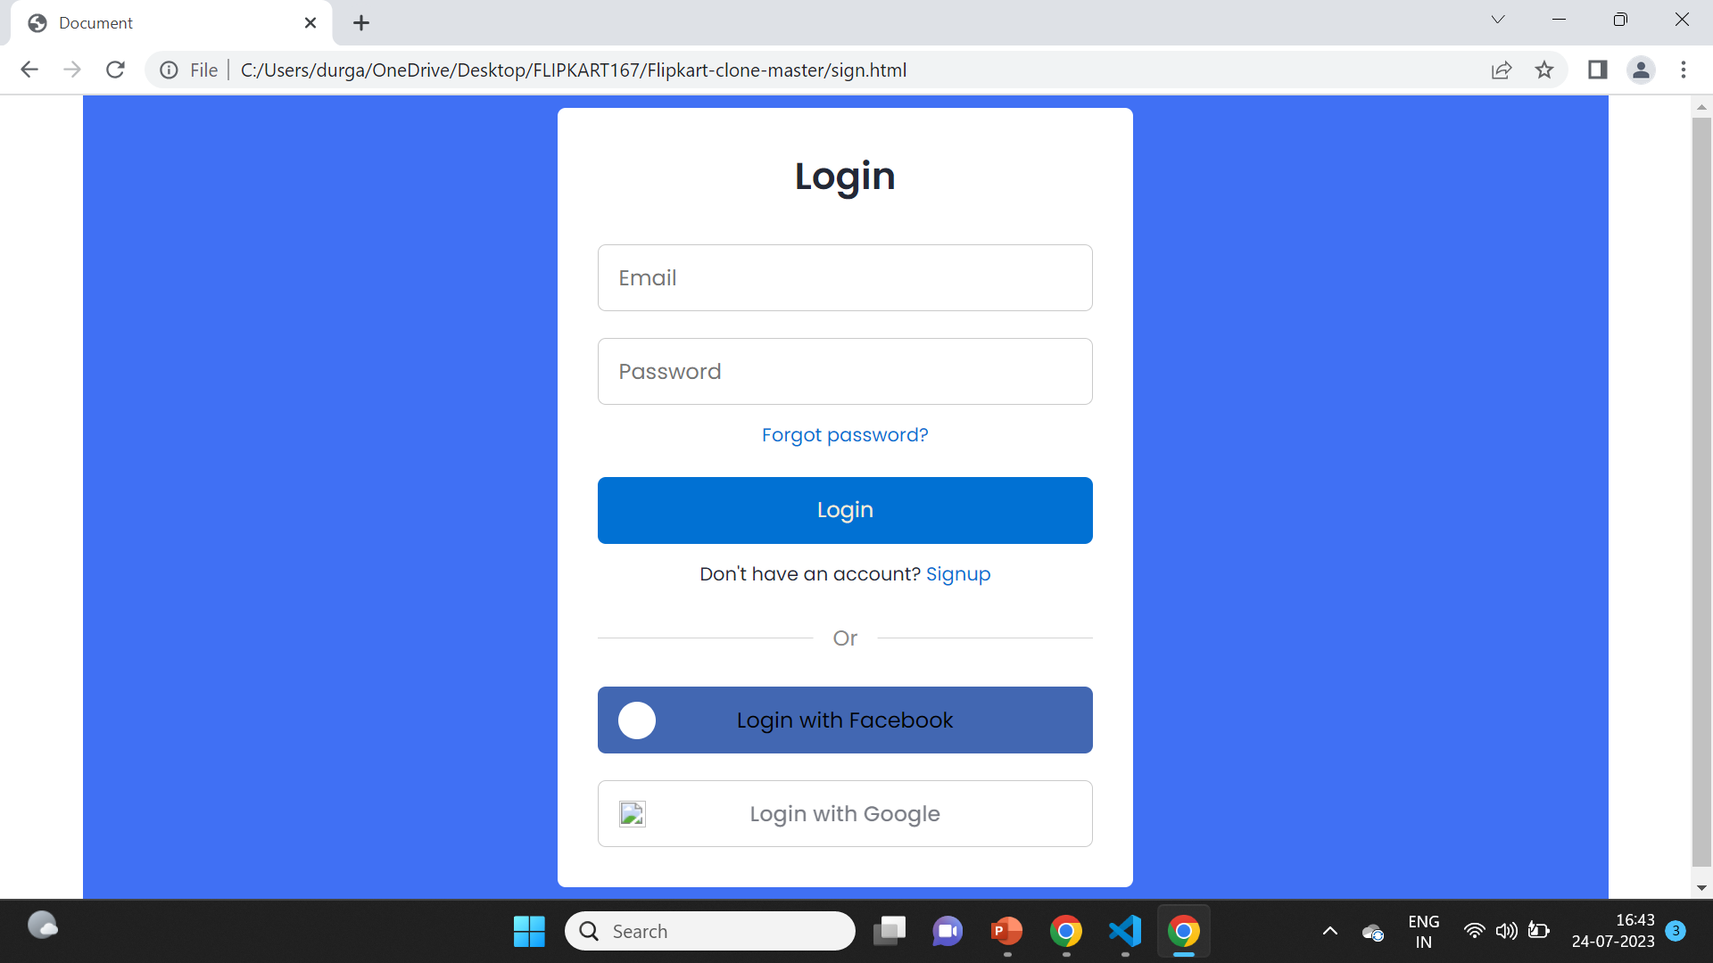
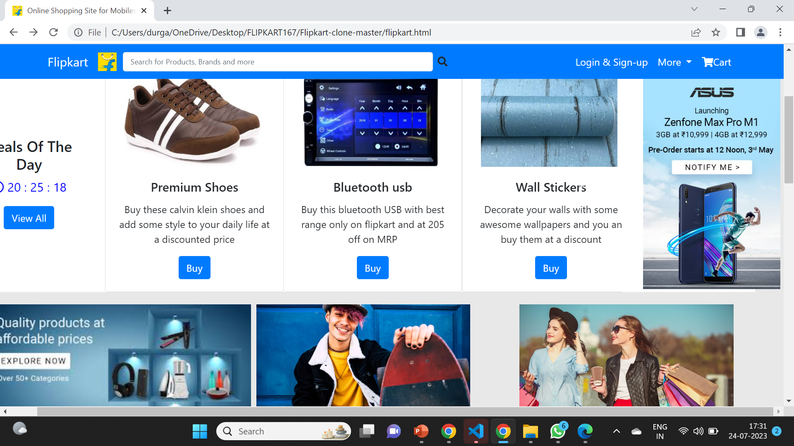
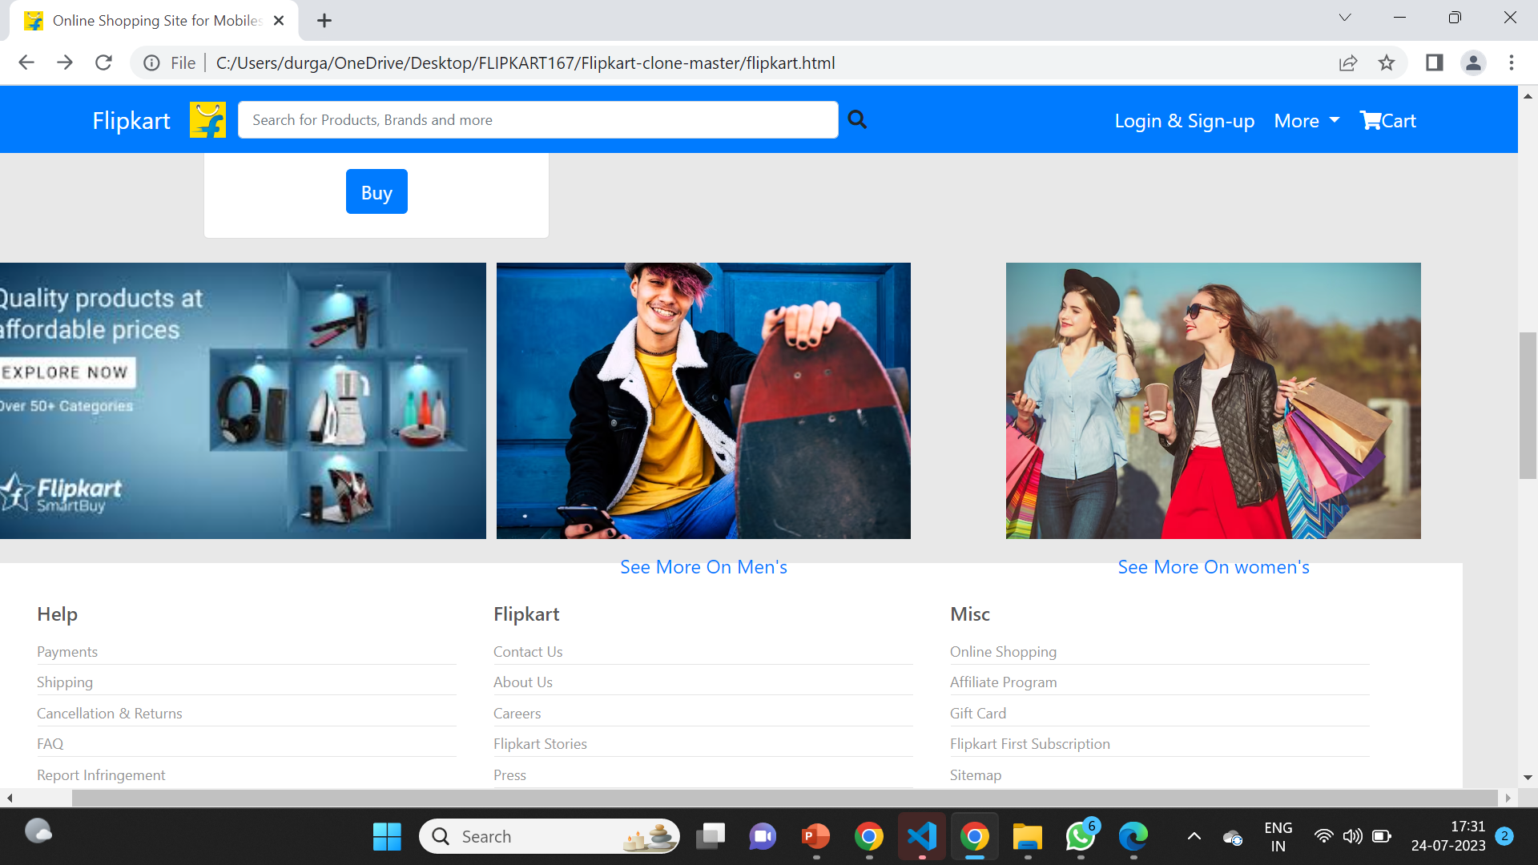
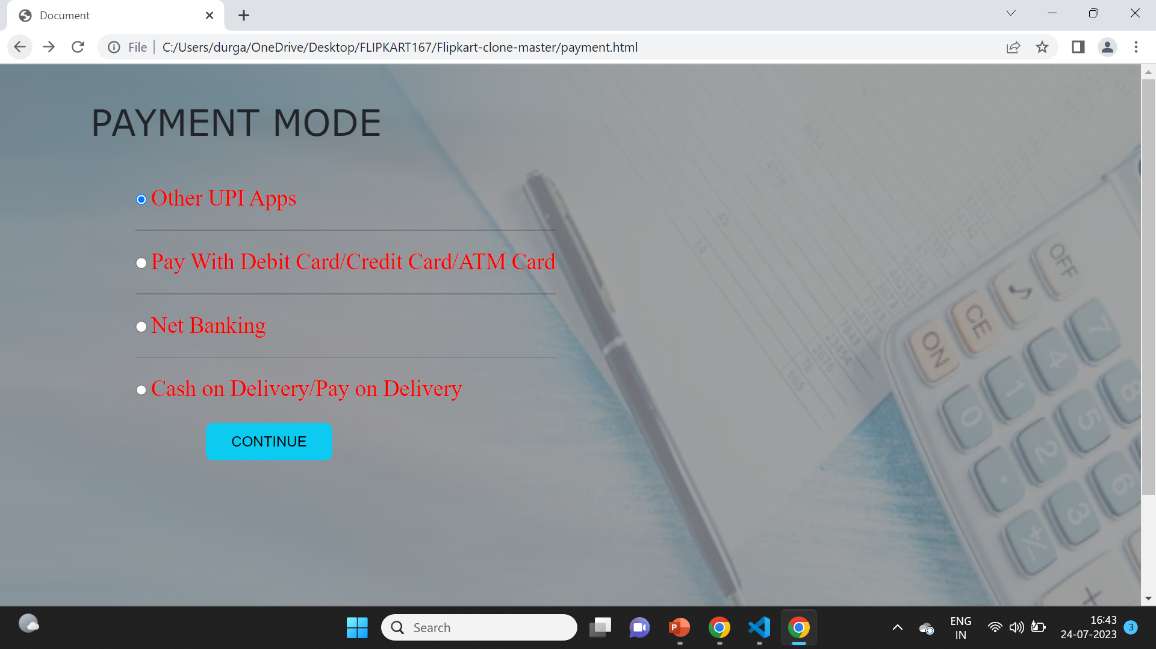
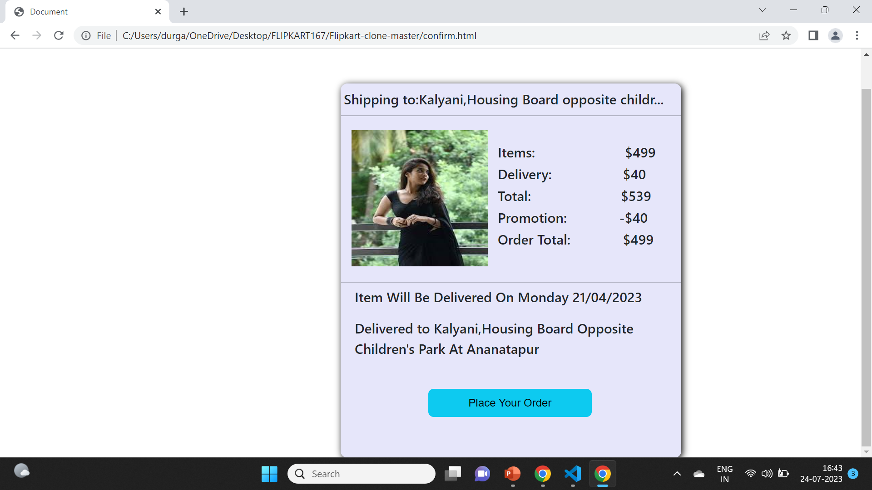
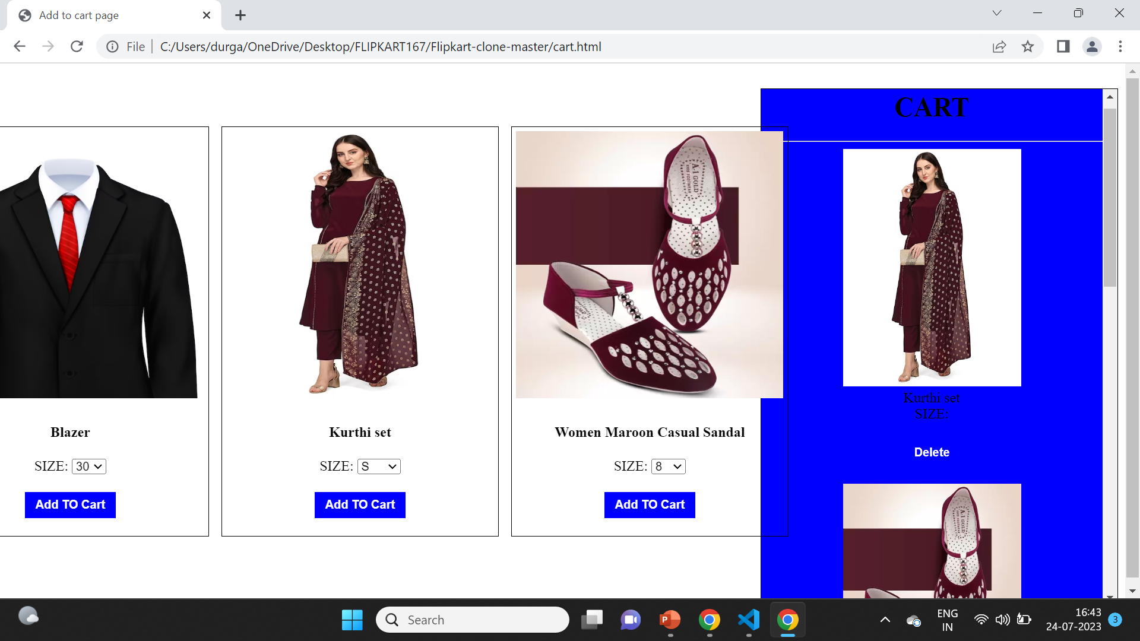
MODELLING

Slide 9
Results
My project website caters to the exchange of goods and services for electronic transaction of money as well as Cash-On-Delivery (COD). People can visit your website, choose the products they like, enter the required details, make payment (or choose to pay later), and purchase goods and services.

Slide 10
links
Anitha1903/flipcart: clone website (github.com)
The above one is the link for my project in github.
1R2D5RG4DLkNm0imtCqeUwoBjtD7RevJd
Its my project source code.
C:\Users\durga\Downloads\Online Shopping Site for Mobiles, Fashion, Books, Electronics, Home Appliances and More - Google Chrome 2023-07-24 16-42-39.mp4
Video link for my project.

Slide 11
Thank you
PREPARED BY:
Student Name : Vellam Chetty sri durga Vijaya Bhavani
Email:durgabhavanivc@gmail.com
AICTE internship student registration id:STU6436b440690461681306688
Contact number:7702691554

